Slide 1

PRODYNA
FROM ZERO TO HERO WITH KUBERNETES

Slide 2
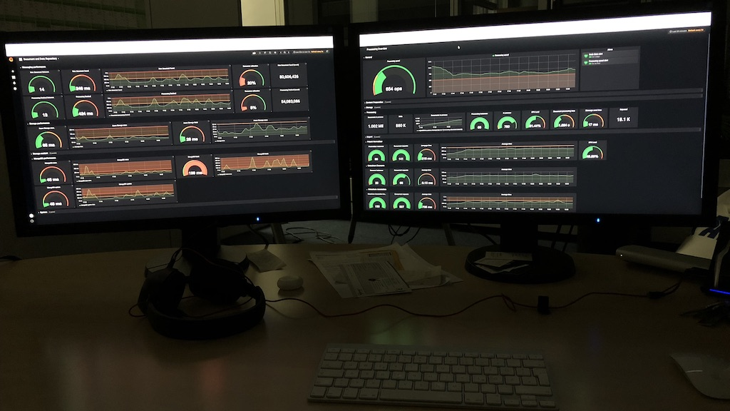

Slide 3

Kubernetes cluster
150 nodes
2300 cores
16TB RAM
Running on Azure
Development on Minikube
Running
15 business services
Developed by PRODYNA
Neo4j
ElasticSearch
MongoDB
RabbitMQ
Prometheus
Grafana

Slide 4
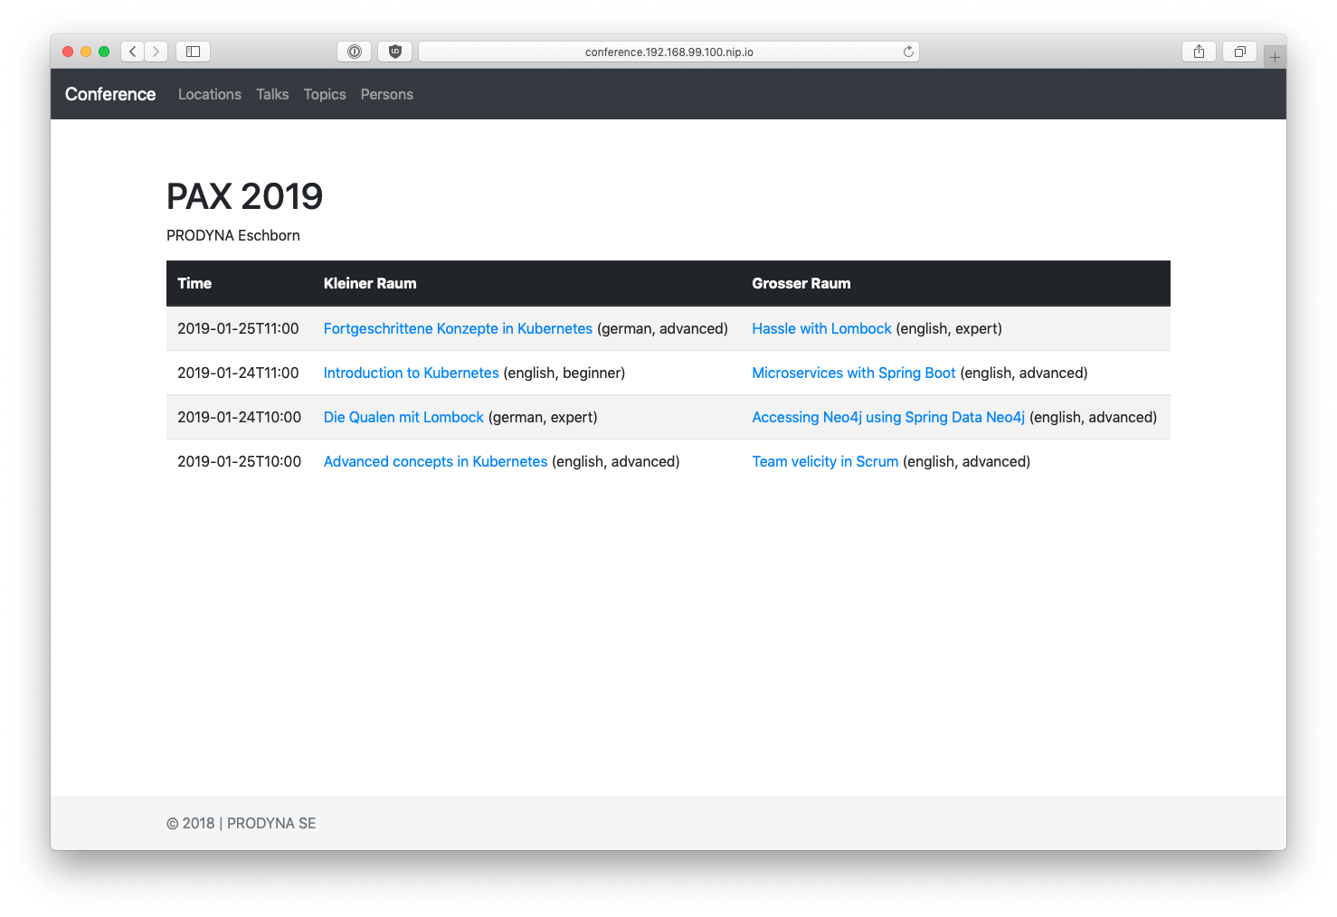
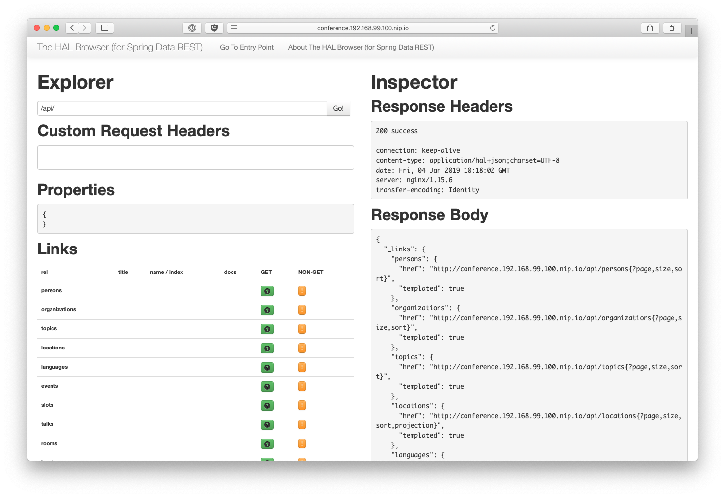
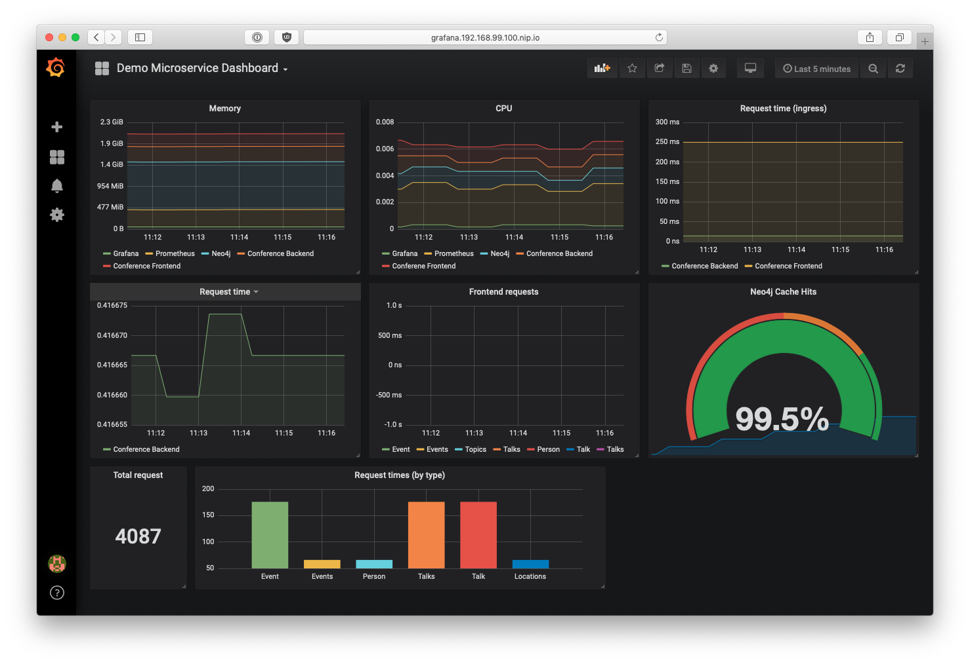
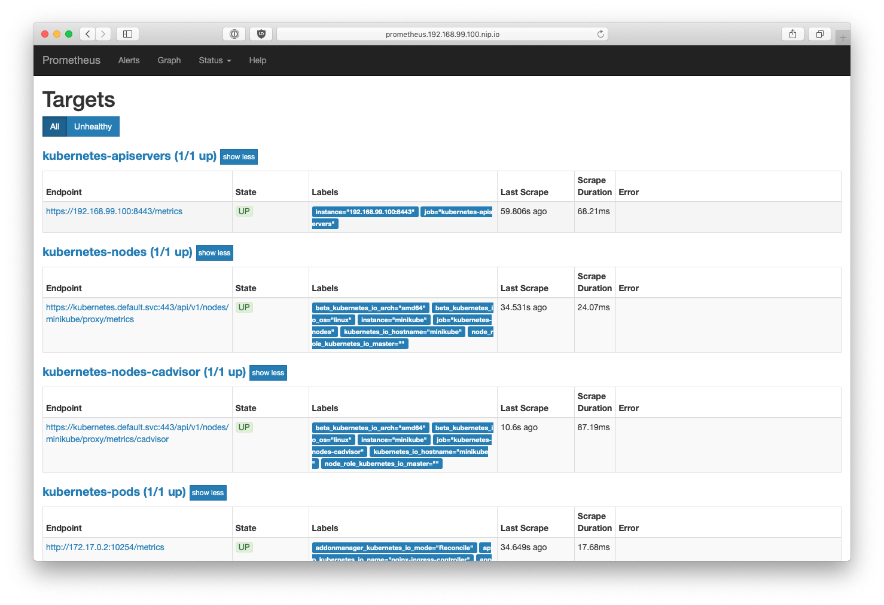
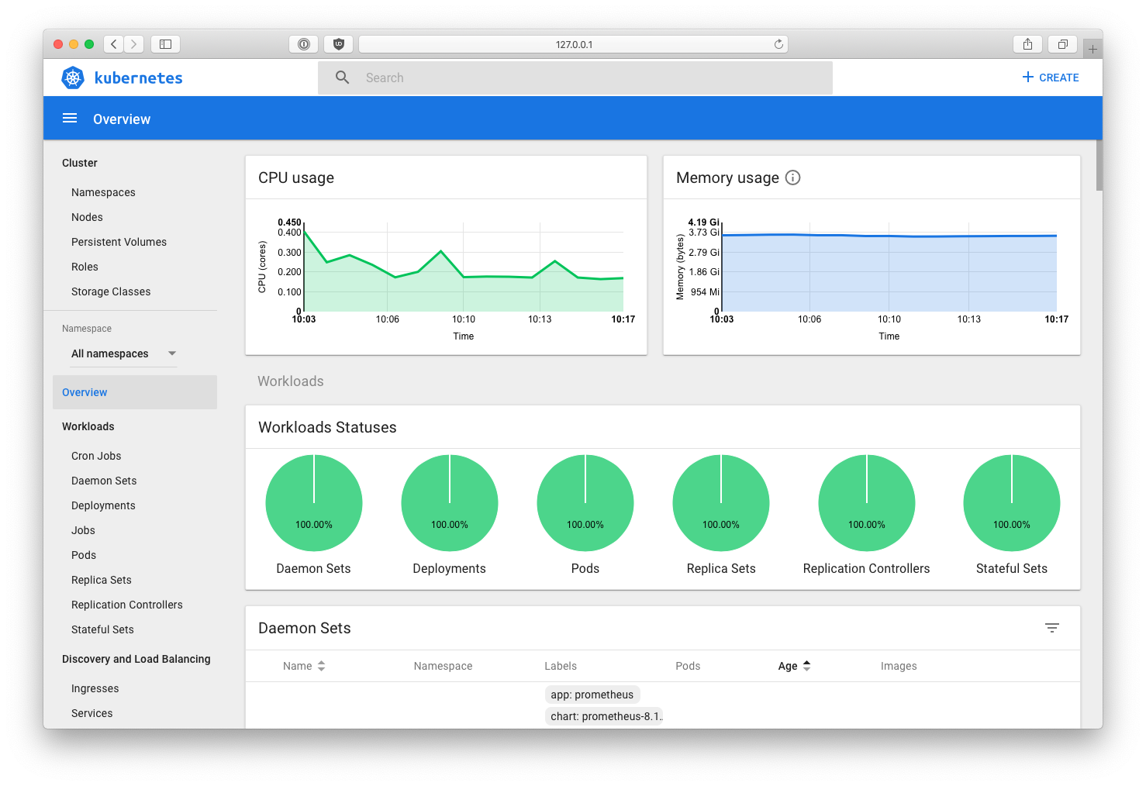
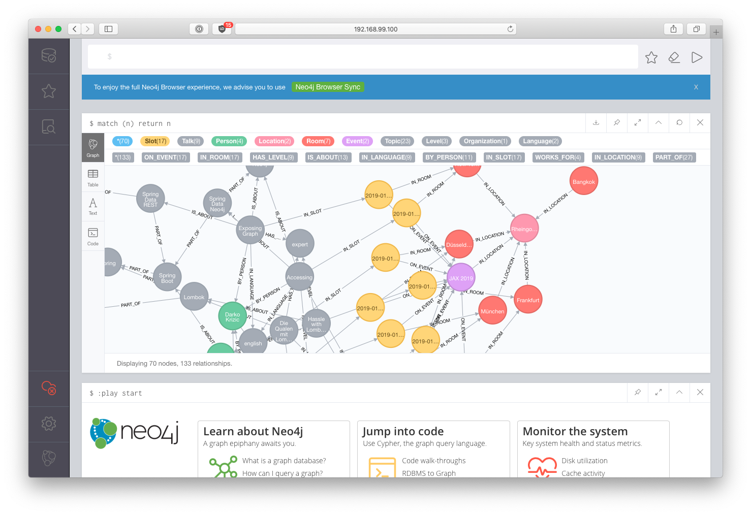
Conference
Frontend
http://conference.minikube/
Conference
Backend
conference/
80
conference/api
Ingress Controller
443
http://conference.minikube/api
Prometheus
prometheus
Dashboard
2001
grafana
Neo4j
Grafana
http://grafana.minikube/
Conference
Data
32K10
32K11
http://prometheus.minikube/
bolt://minikube:32001
http://minikube:2001/
Conference
Backend
Conference
Frontend
http://conference.minikube/api
http://minikube:32010
bolt://minikube:32011

Slide 5
PROJECt REPOSITORY

Slide 6
Technologies for development
Java | The actual ecosystem
Spring | Java framework for Microservices
Maven | Build and Dependency management
IntelliJ | Framework for development
Docker | Handling docker images

Slide 7
Technologies for RUNtime
Kubernetes | Orchestrator for clusters
Minikube | Single node version of Kubernetes
Neo4j | Graph database
Docker | Used inside of Kubernetes
Prometheus | Collector for metrics
Grafana | Visualization for metrics

Slide 8
INSTALLATION
MAC SPECIFIC – similar on linux
brew cask install java virtualbox minikube
brew install maven docker kubernetes-cli kubernetes-helm

Slide 9
Starting point
Command line tools
maven – Building the sources
kubectl – Controlling Kubernetes
docker – Building and managing docker images
helm – For managing installations on Kubernetes
minikube – For managing a local installation of Kubernetes for development
virtualbox – The actual virtual machine minikube runs on
Other software
IntelliJ – The DIE used (many alternatives)
Java– The Java runtime and compiler

Slide 10
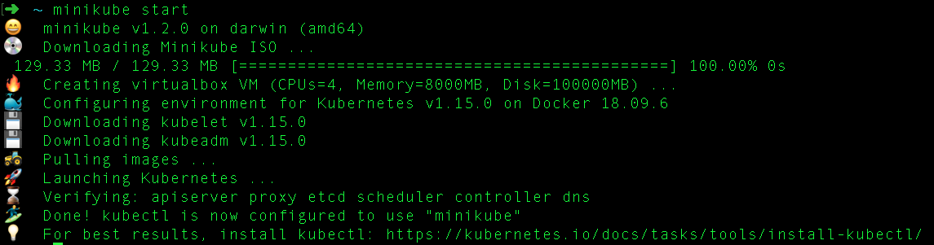
BOOTSTRAP MINIKUBE
minikube config set cpus 4
minikube config set memory 8000
minikube config set disk-size 100g
minikube config view
minikube start

Slide 11
ADD MINIKUBE IP TO LOCAL HOSTS

Slide 12
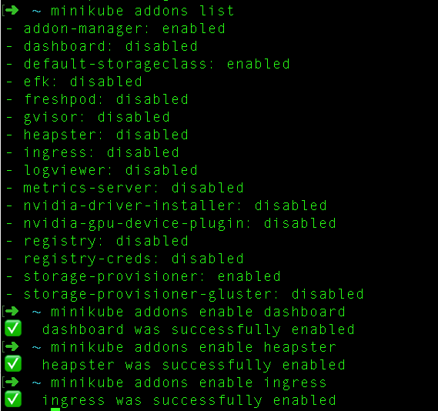
ACTIVE SOME MINIKUBE ADDONS

Slide 13
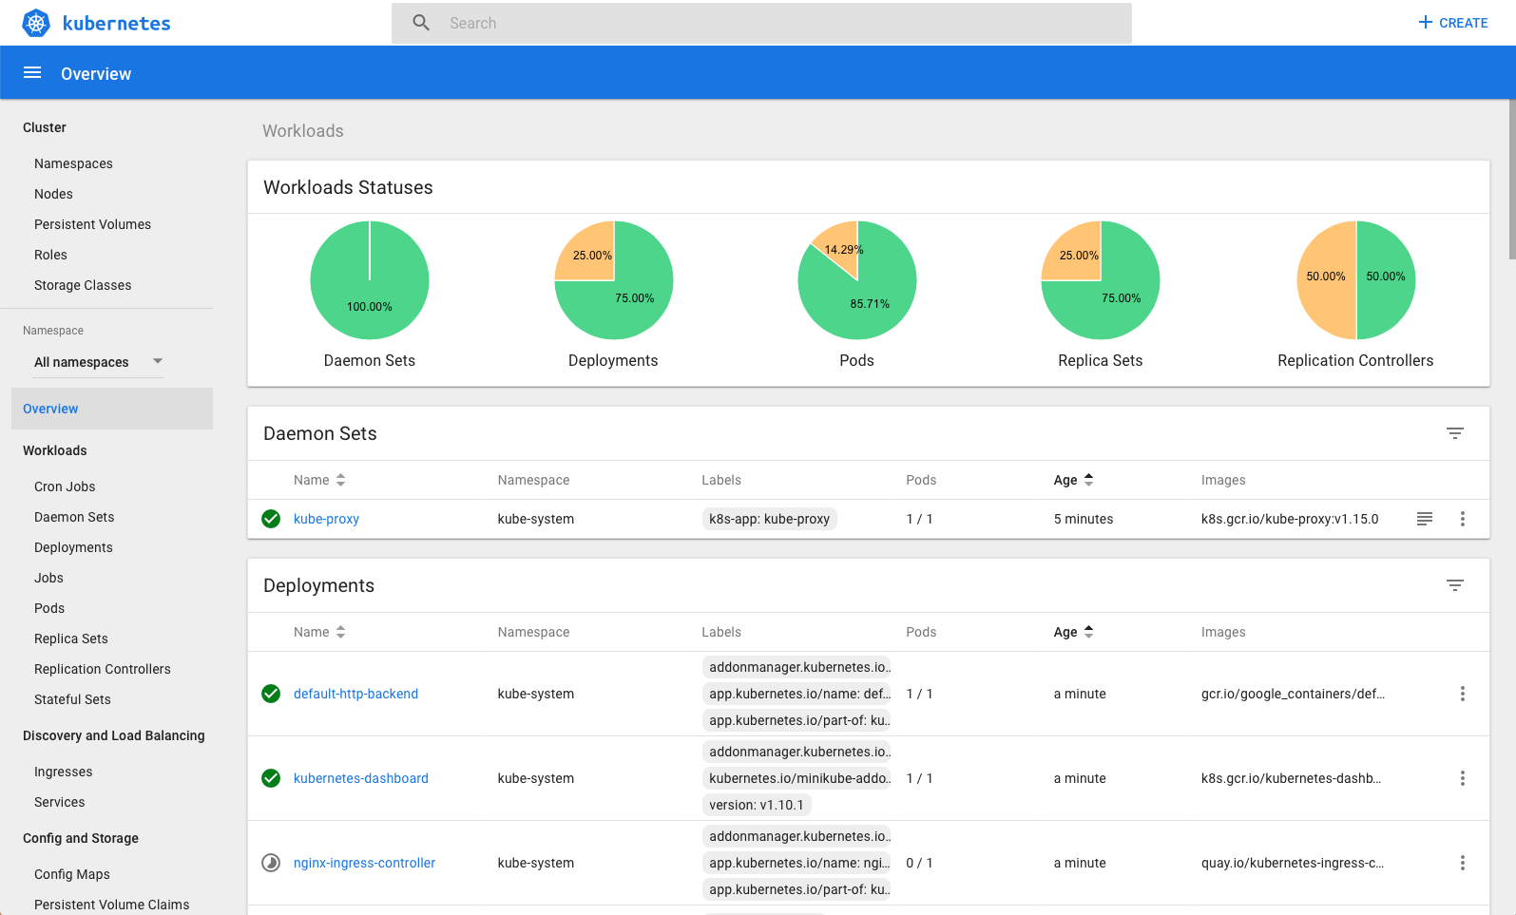
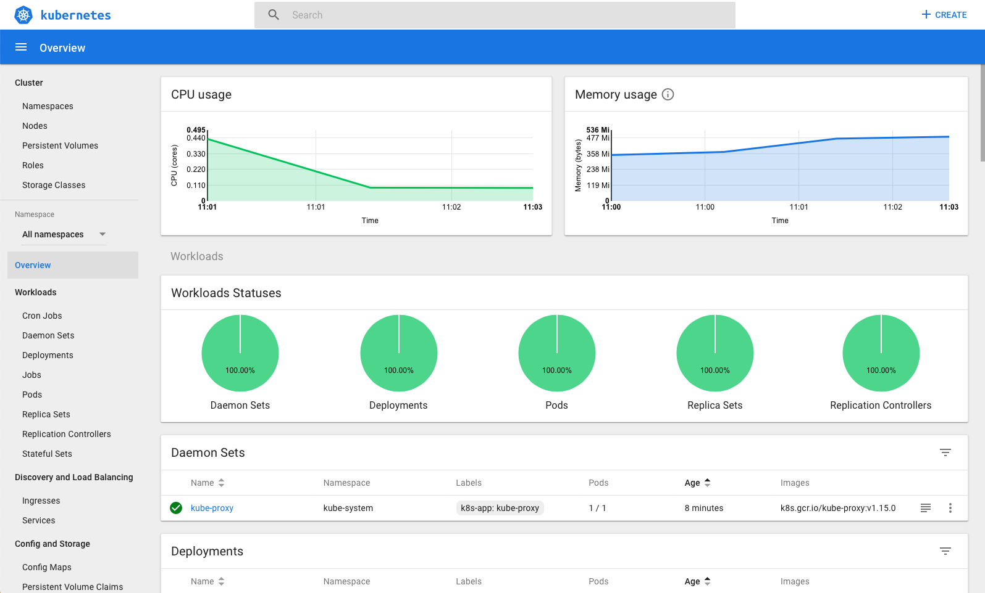
OPEN DASHBOARD

Slide 14
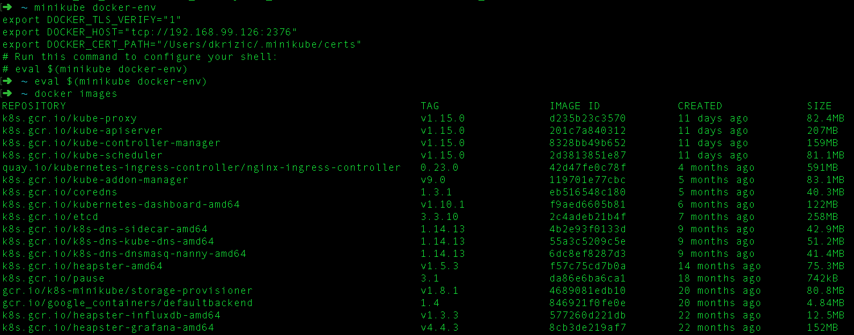
ACCESS DOCKER IN MINIKUBE

Slide 15
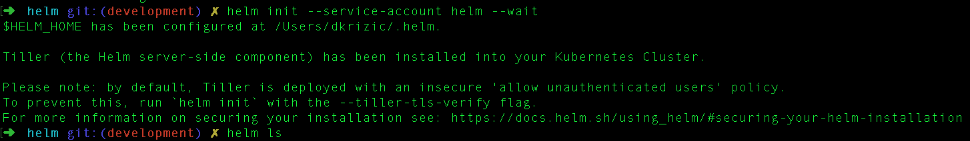
INSTALL HELM

Slide 16
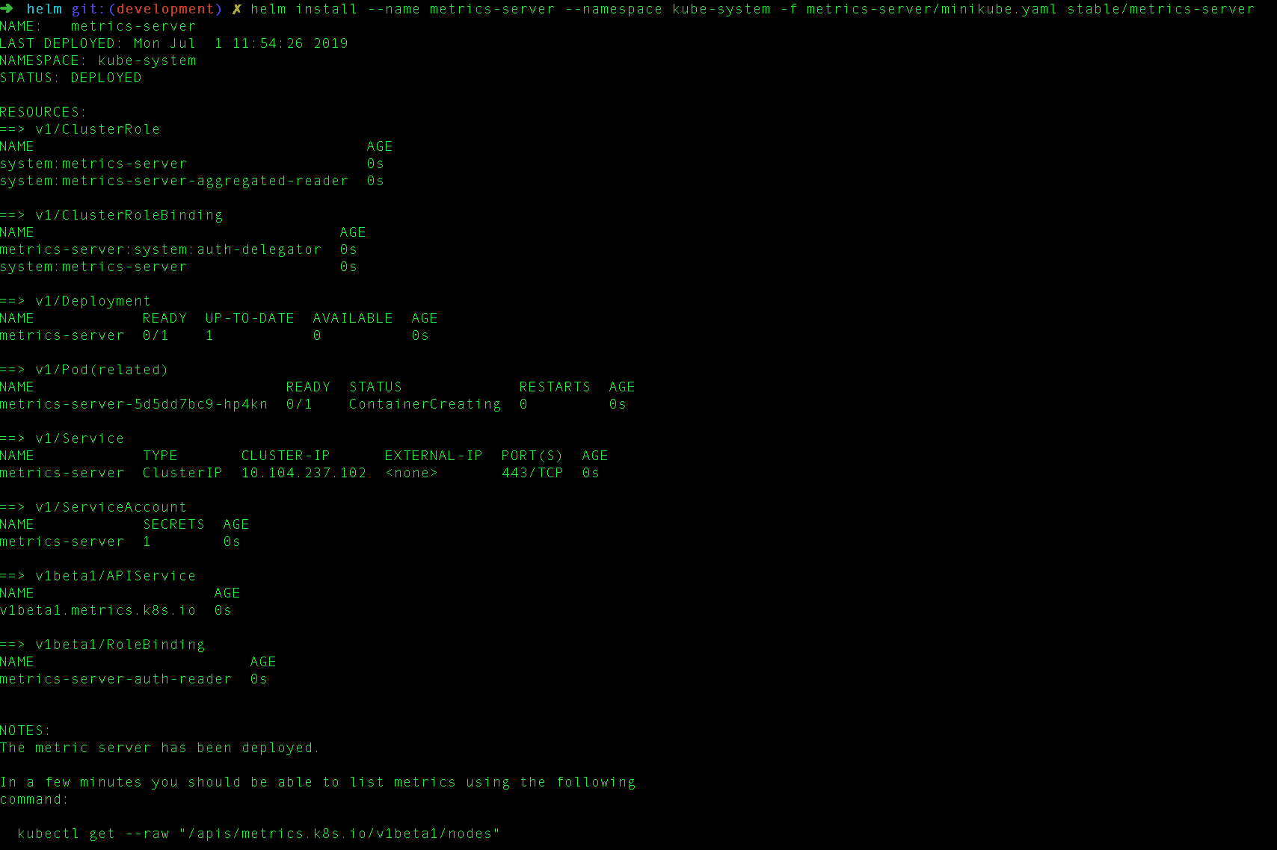
INSTALL METRICS-SERVER VIA HELM

Slide 17
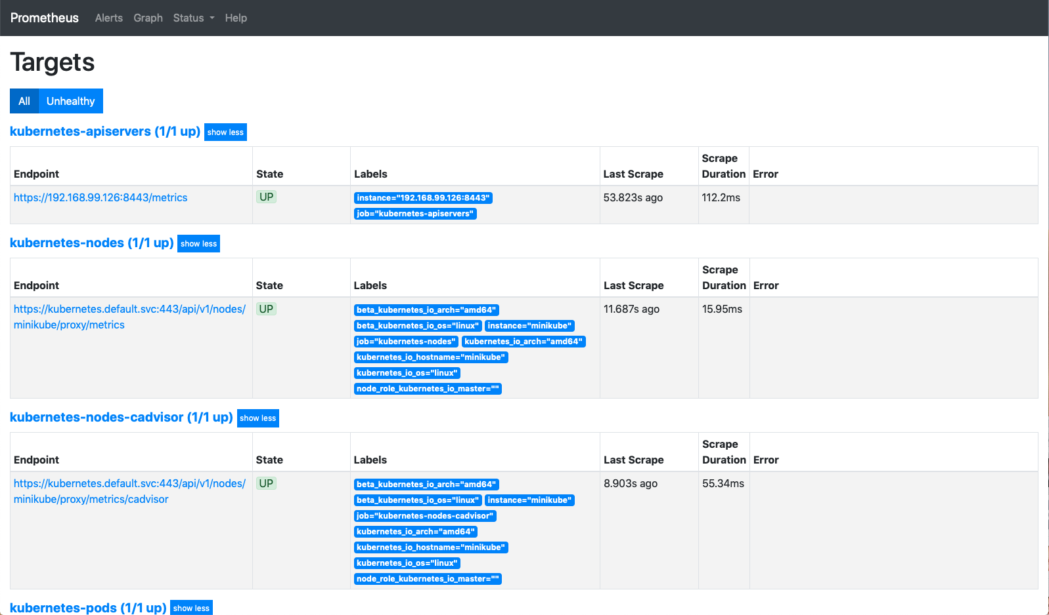
INSTALL PROMETHEUS VIA HELM
ACCESS HTTP://PROMETHEUS.MINIKUBE

Slide 18
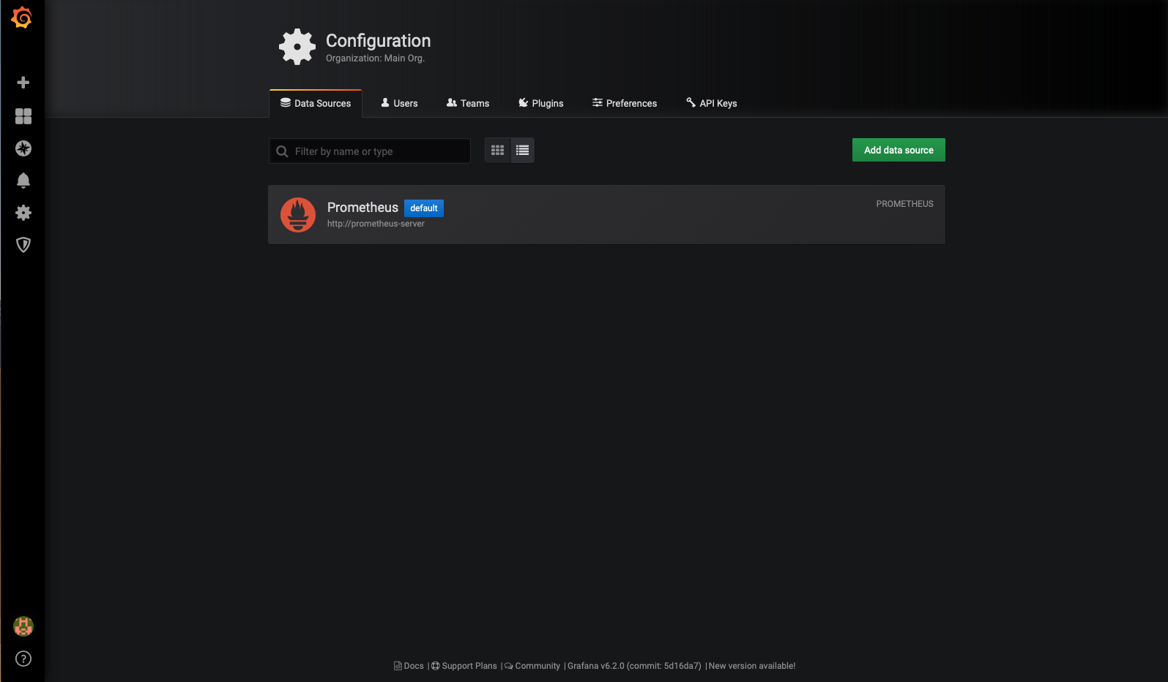
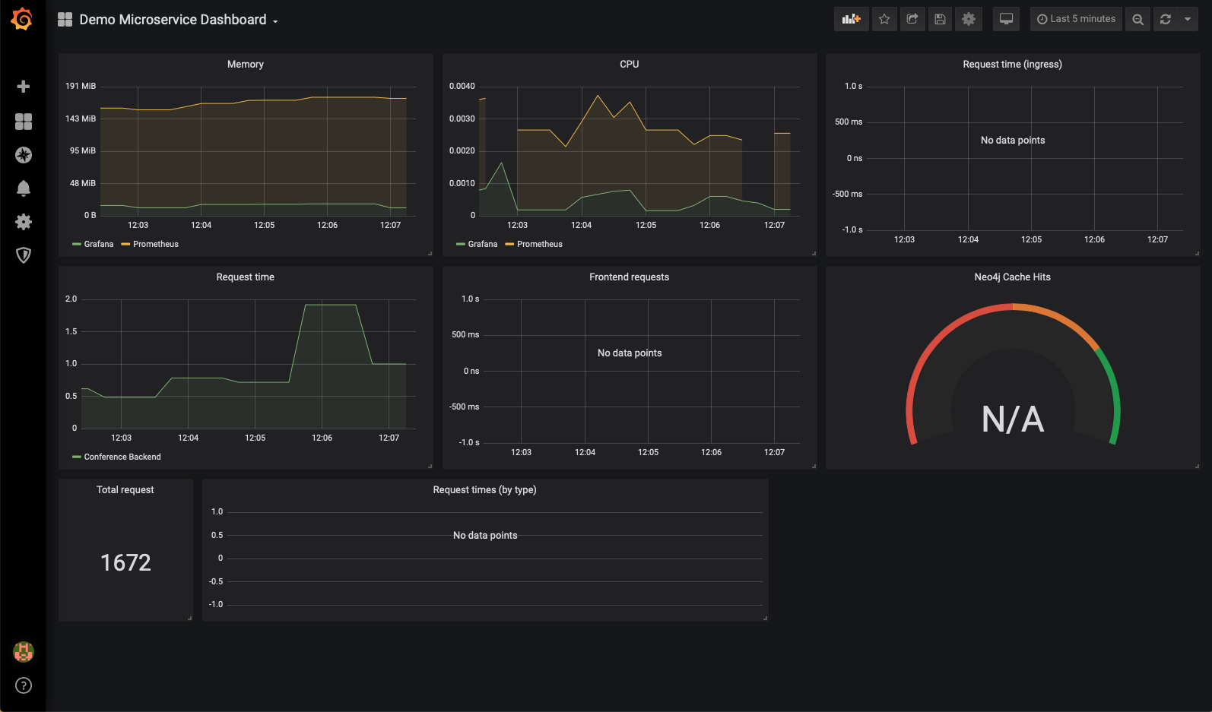
INSTALL GRAFANA VIA HELM
ACCESS VIA HTTP://GRAFANA.MINIKUBE

Slide 19
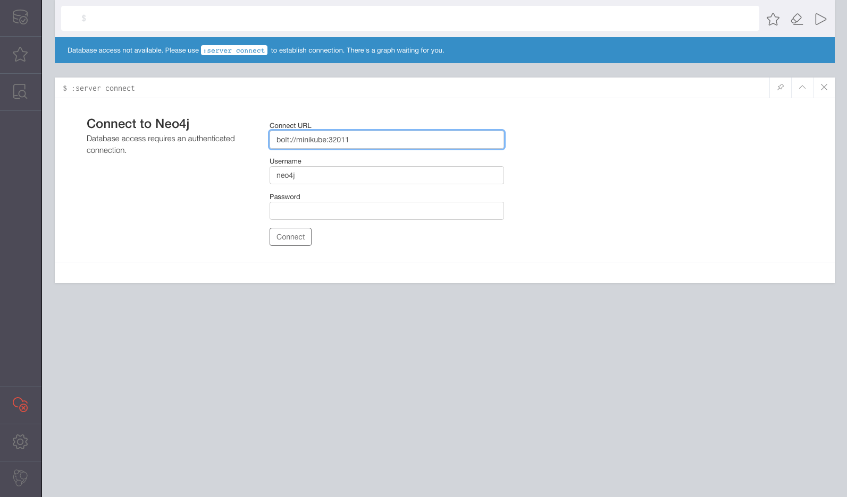
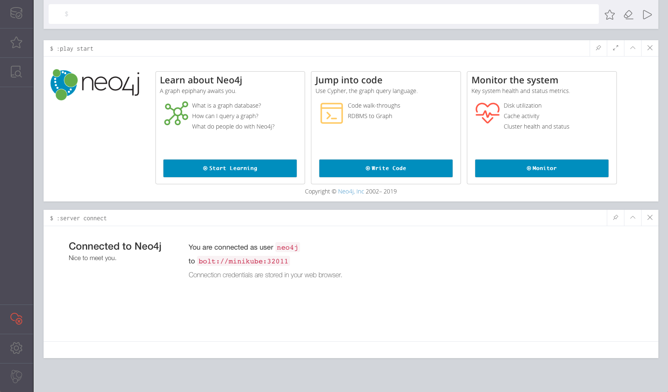
INSTALL NEO4J VIA HELM
ACCESS VIA HTTP://MINIKUBE:32010 CONNECT TO BOLT://MINIKUBE:32011

Slide 20
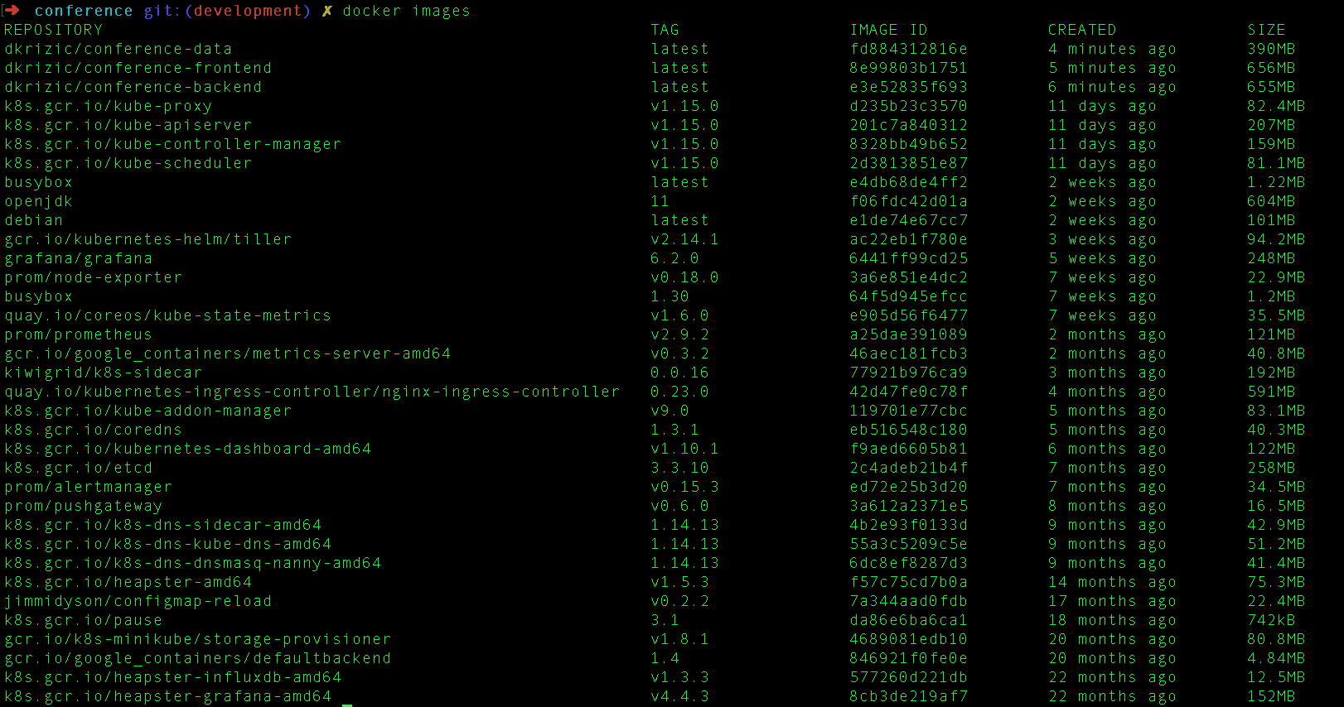
BUILD SOURCES
eval $(minikube docker-env)
mvn install
docker images

Slide 21
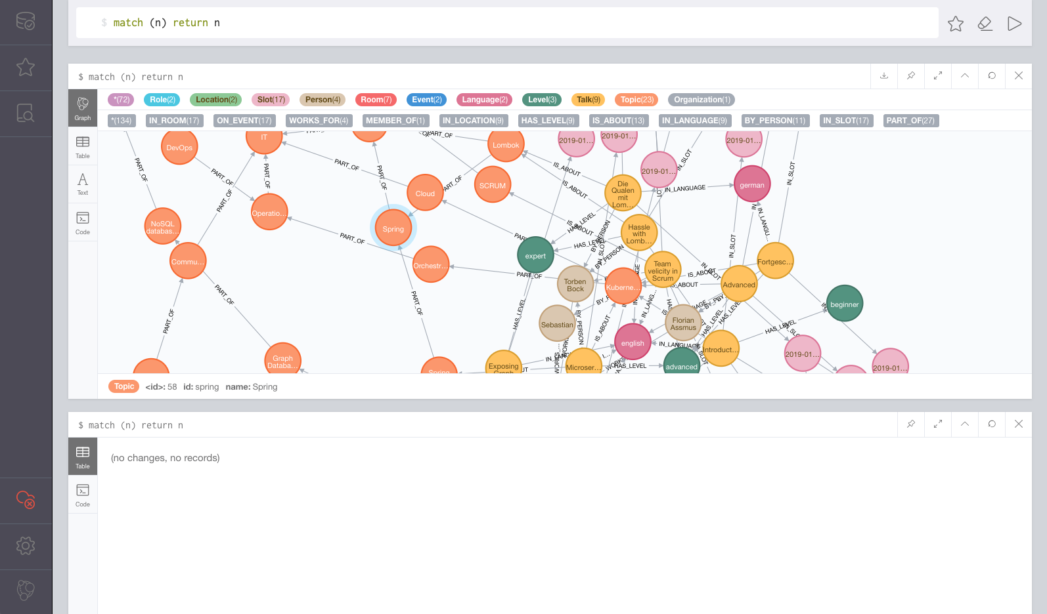
INSTALL Conference-data importer via HELM

Slide 22
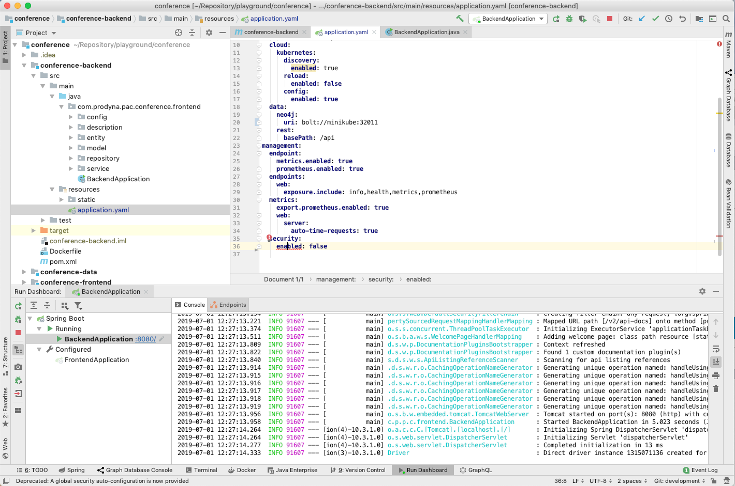
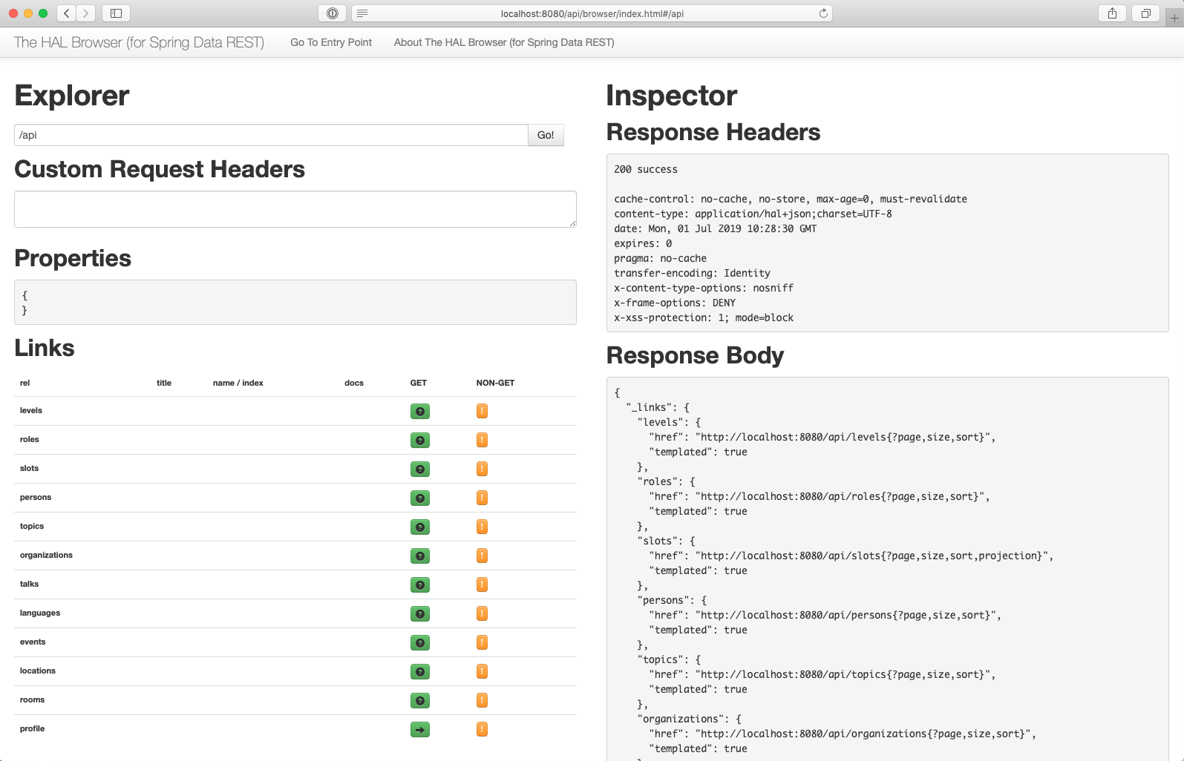
RUN BACKEND IN IDE
ACCESS VIA HTTP://LOCALHOST:8080

Slide 23
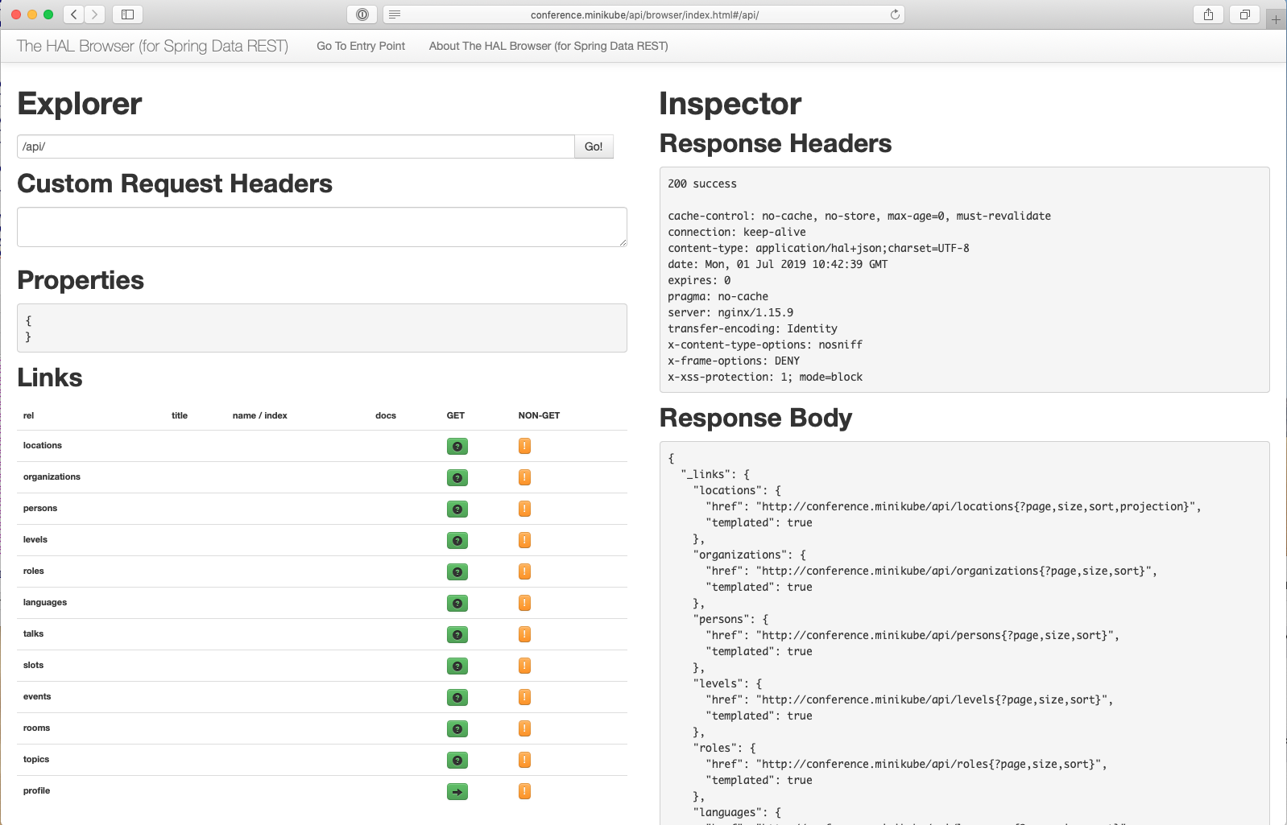
DEPLOY BACKEND VIA HELM
ACCESS VIA HTTP://COnference.backend/api

Slide 24
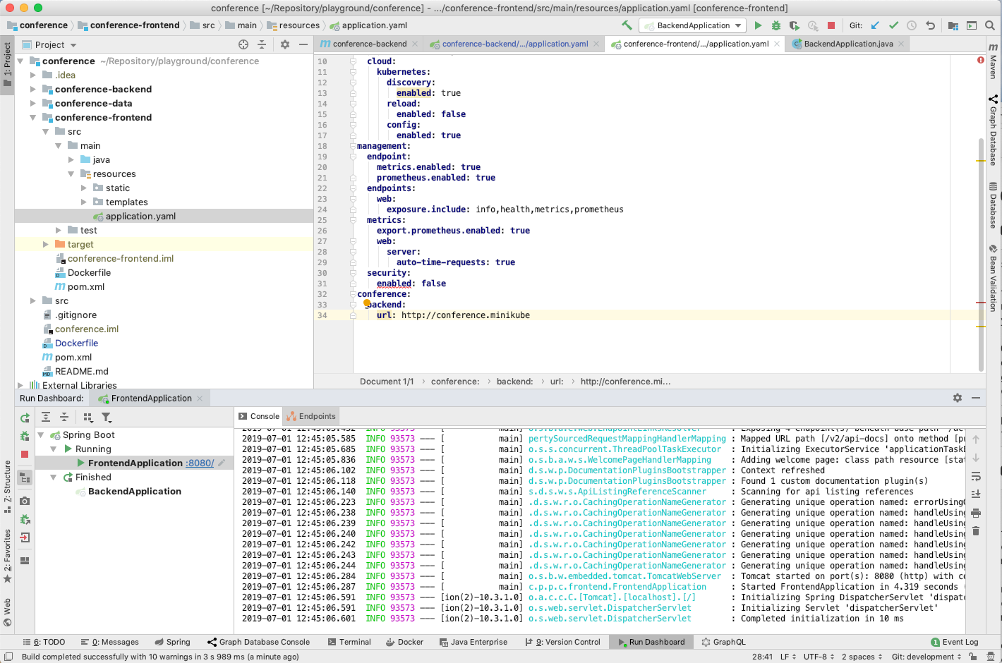
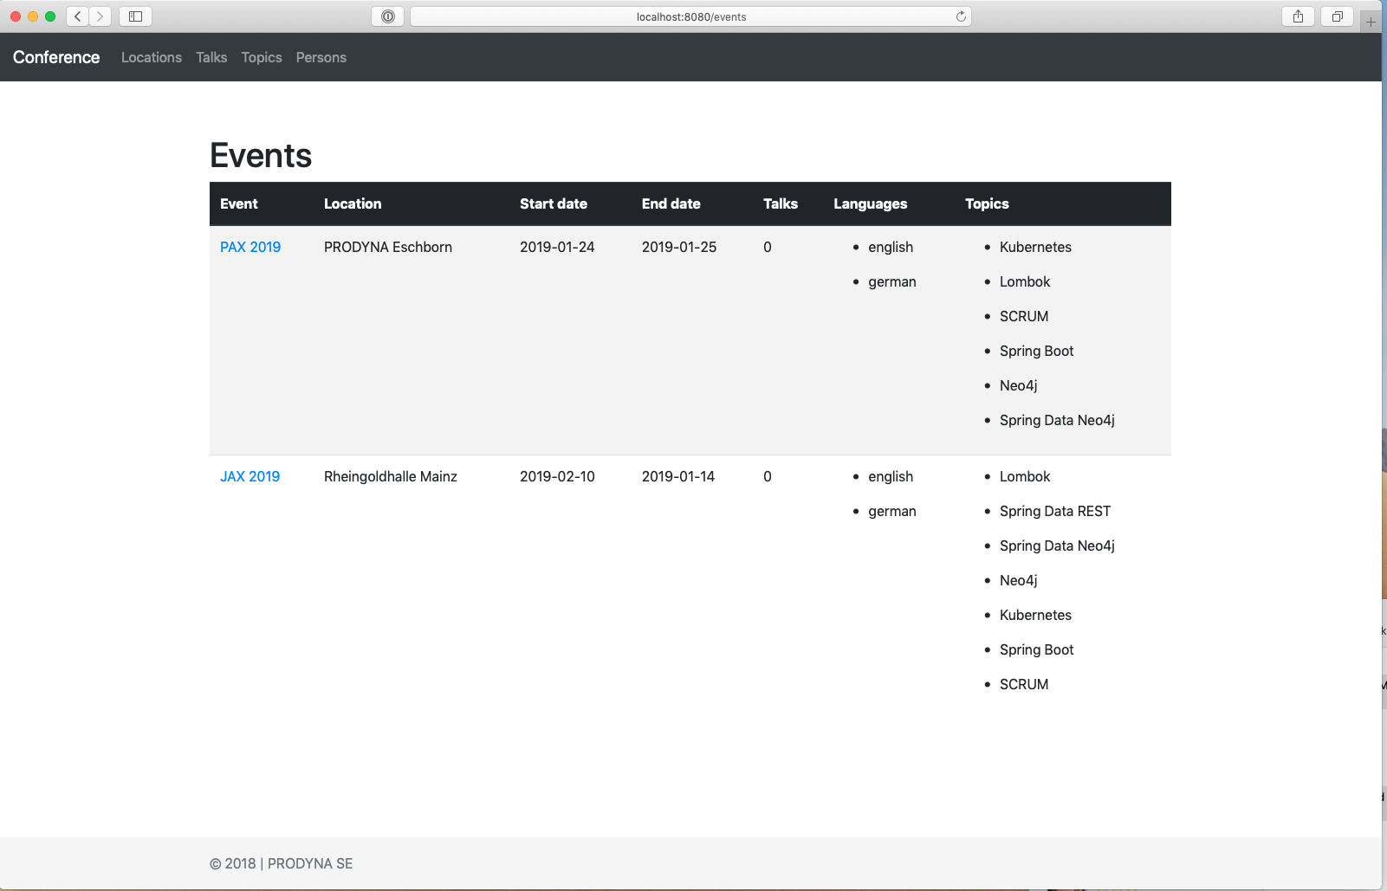
Start frontend in IDE
Access via http://localhost:8080

Slide 25
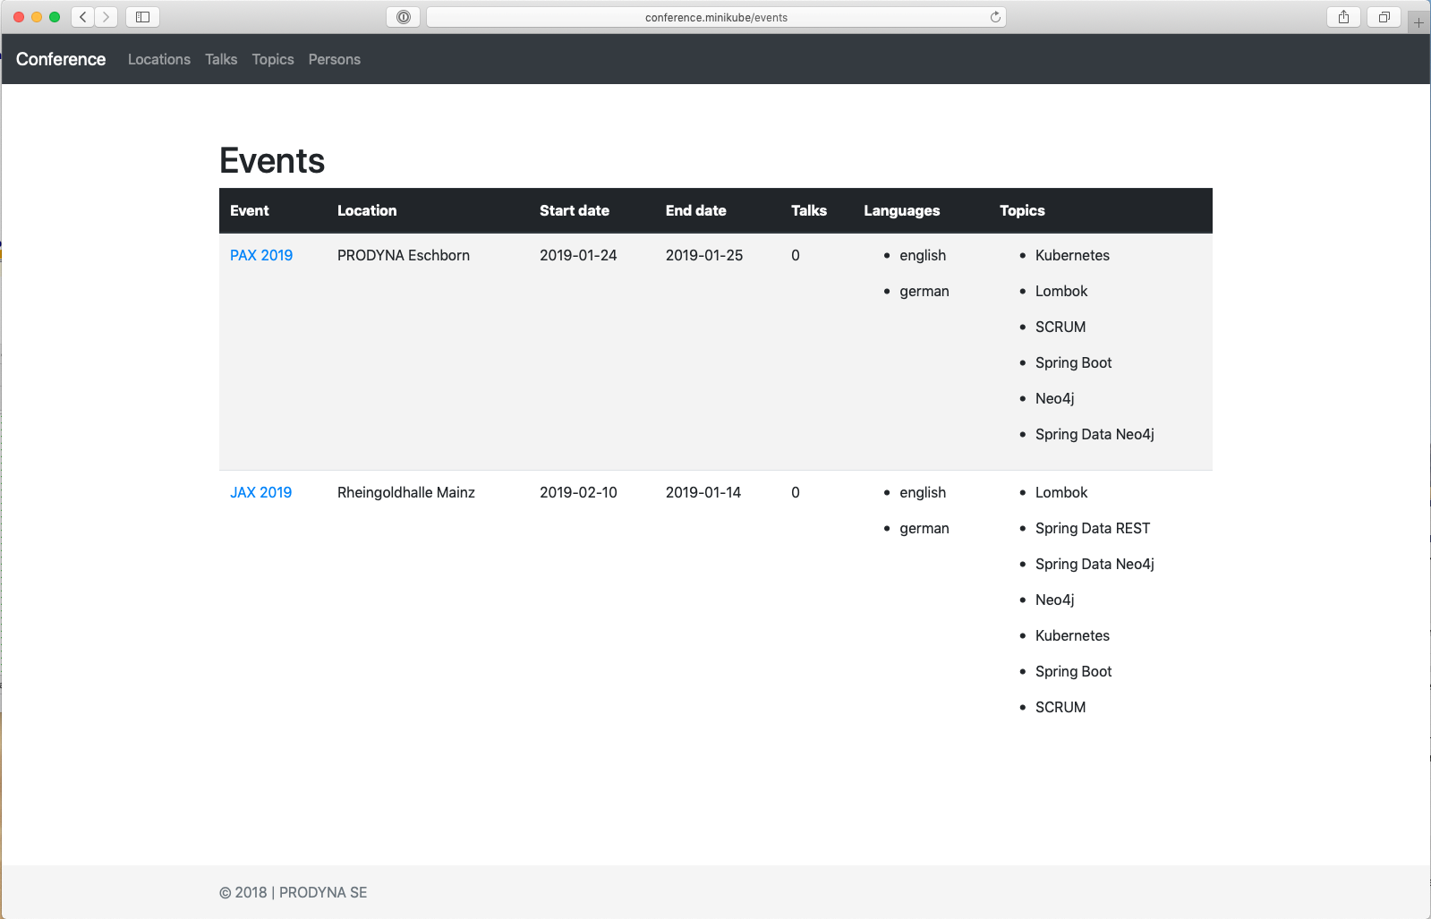
Deploy frontend via HELM
Access via http://conference.minikube

Slide 26
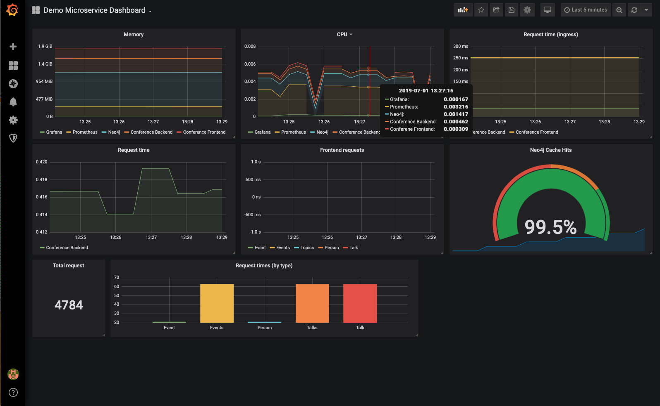
ALL VALUES IN GRAFANA

